Slide 1
290O Images
Feb 11 2019

Slide 2
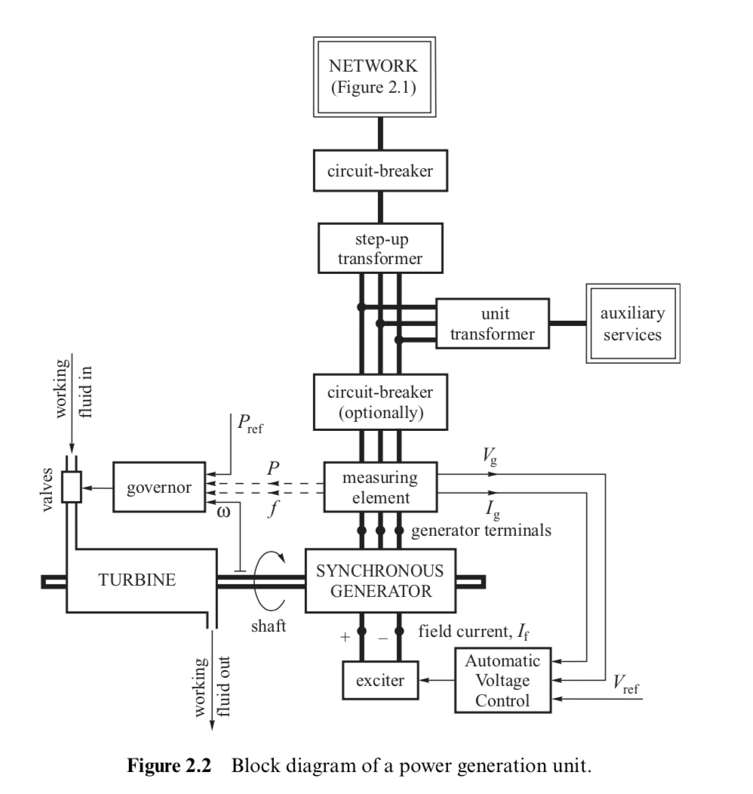

Slide 3
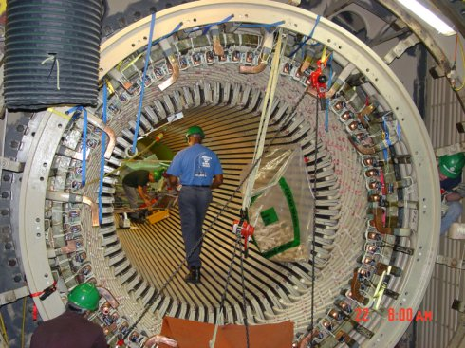
Armature & Stator
Browns Ferry nuclear power plant Unit 1 refurbishing
~1.2 GW
http://www.eia.doe.gov/cneaf/nuclear/page/at_a_glance/states/bfn.jpg

Slide 4
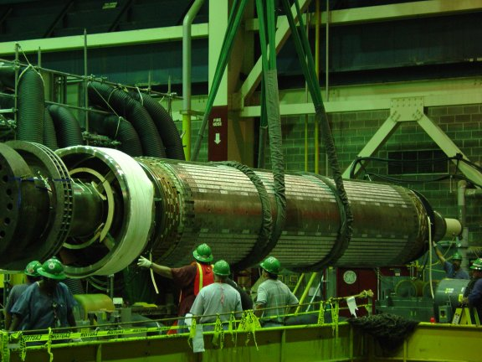
Rotor
Browns Ferry nuclear power plant generator refurbishing
~1.2 GW unit
http://www.eia.doe.gov/cneaf/nuclear/page/at_a_glance/states/bfnrotor.jpg

Slide 5
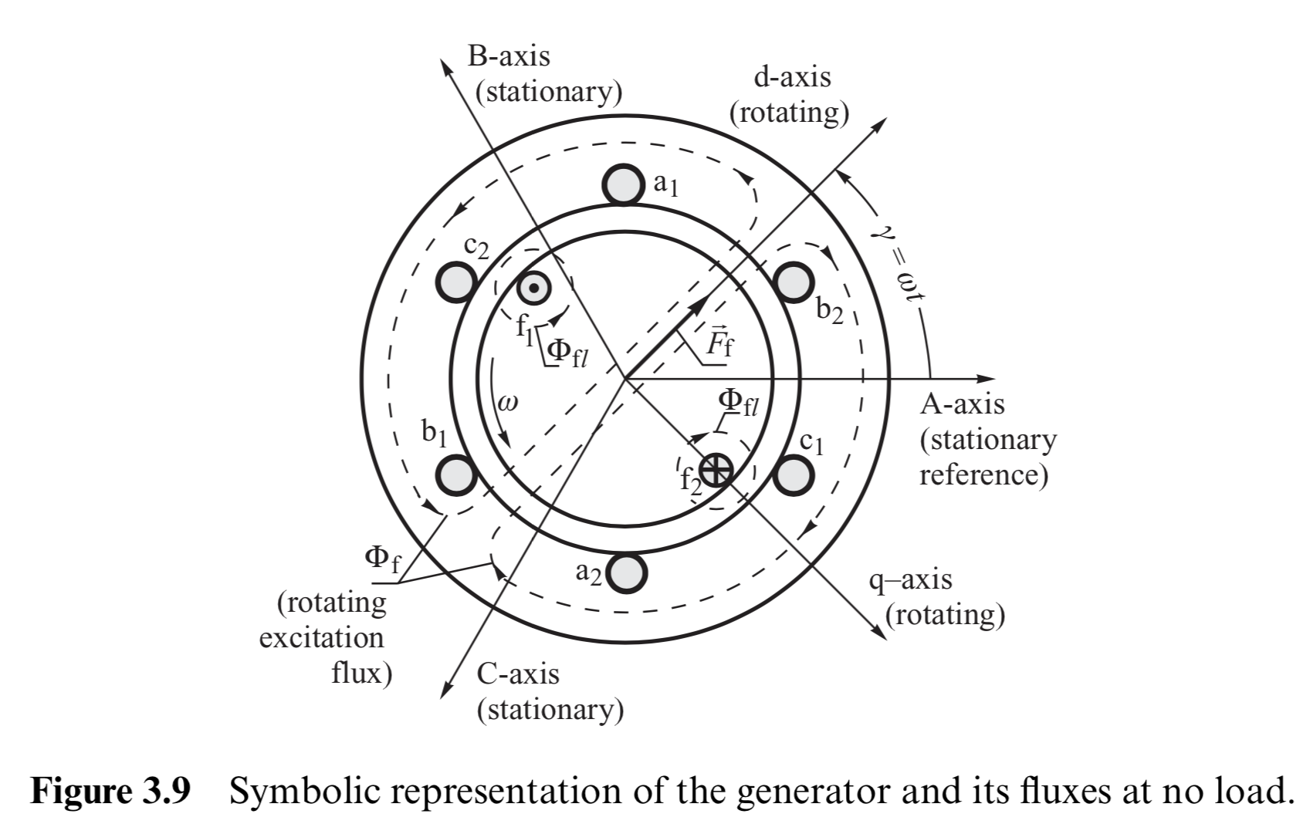

Slide 6
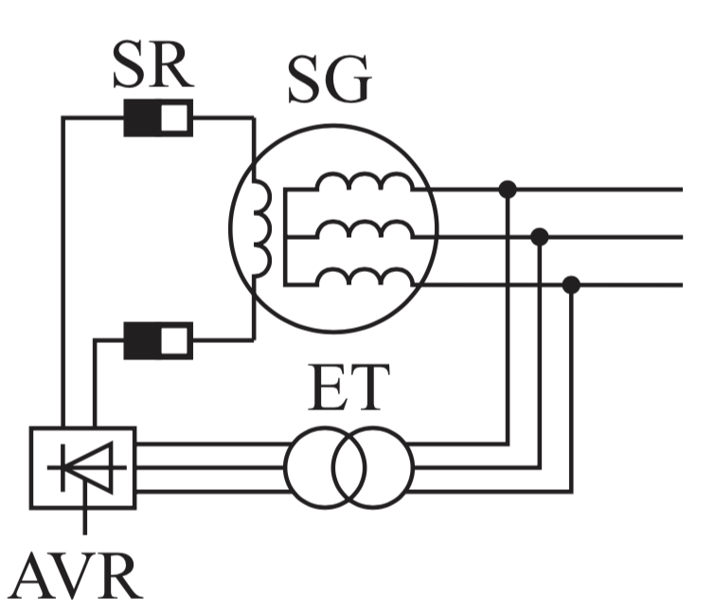
(MBB 2.3e)

Slide 7
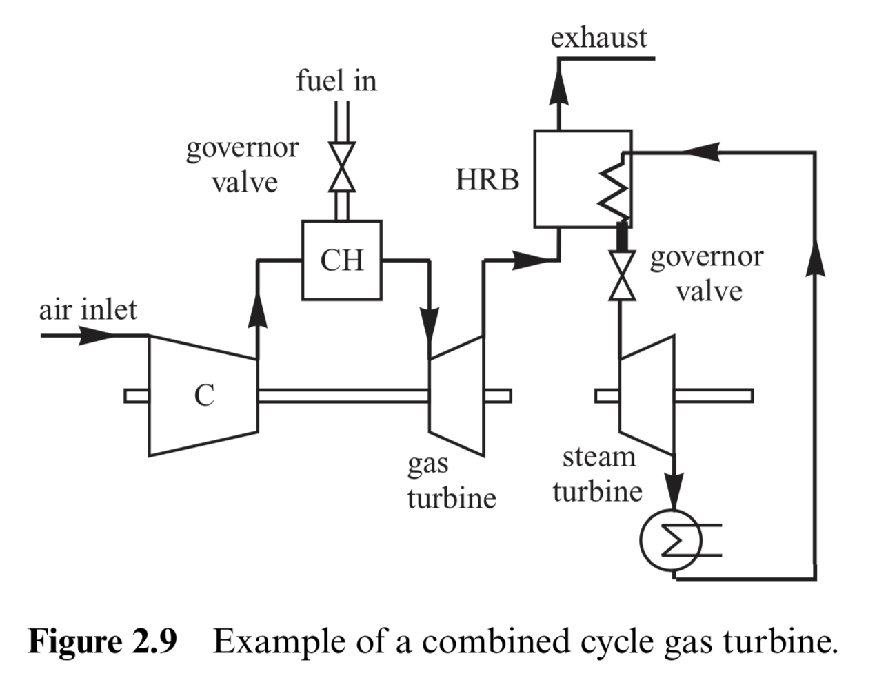

Slide 9
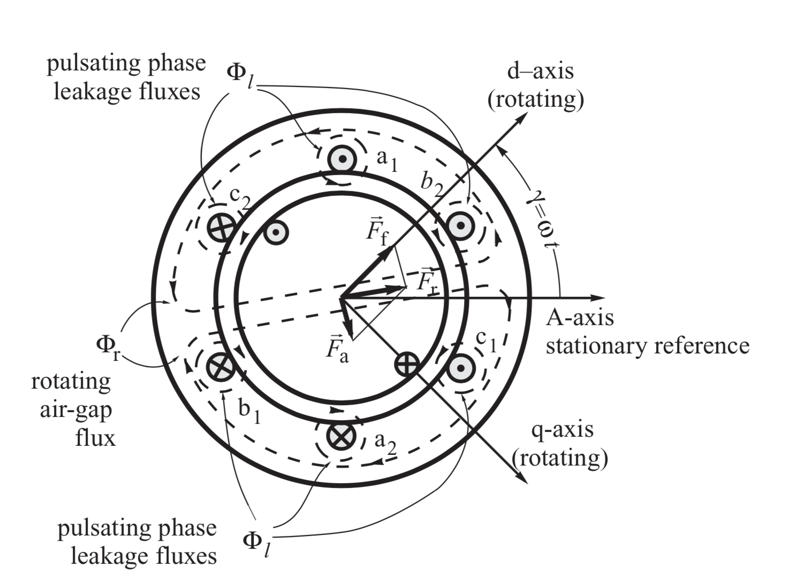
(MBB 3.11)

Slide 10
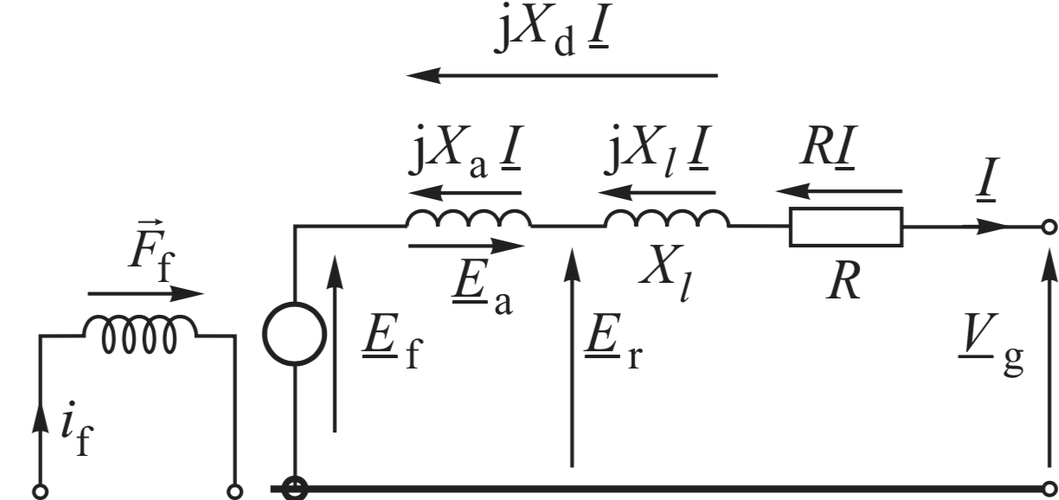
(MBB 3.12a)

